Slide 1
Database DevOps
Extending the Power of DevOps for Database Management

Slide 2
What is Database DevOps
What is Database DevOps
Why teams leave out an important aspect of the process
Database As a Code
The Database Bottleneck
Database DevOps Challenges
How to Overcome Database DevOps Challenges
Problems Database DevOps Helps Solve
Best Practices for Database DevOps
Tools to implement Database DevOps

Slide 3
What is Database DevOps
DevOps is the union of people, process, and products to enable continuous delivery of value to end users
Integrating Database changes as part of a DevOps process
Automating CI/CD for databases
Version Control the Database
Treating database code like application code
Collaboration between Developers and Database Administrators(DBAs)

Slide 4
Why teams leave out an important aspect of the process
Databases are difficult to automate in DevOps environment
Its Database Administrators Work
Lack of knowledge about database automation

Slide 5
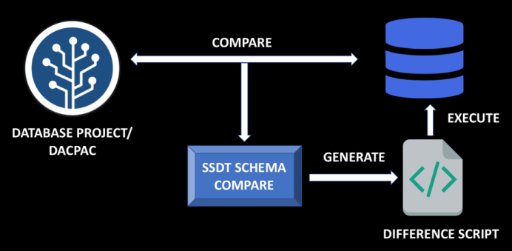
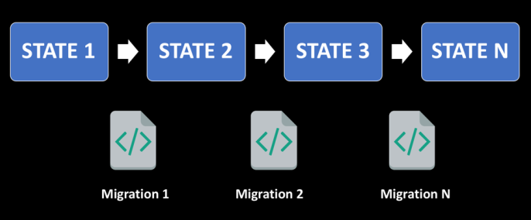
Database As a Code
Managing Database in a Source Code Repository
Database Version Control:
State Based or Migration Based
State Based
Example: SSDT
Migration Based
Example: RedGate ReadyRoll, Flyway
State Based
Migration Based

Slide 6
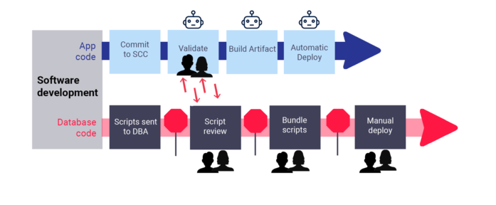
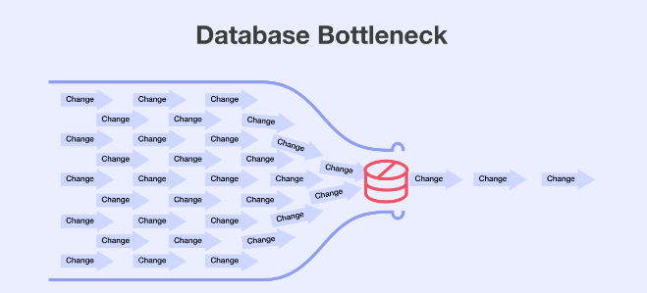
The Database Bottleneck
The Bottleneck: Database Code Changes

Slide 7
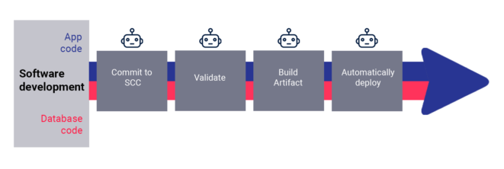
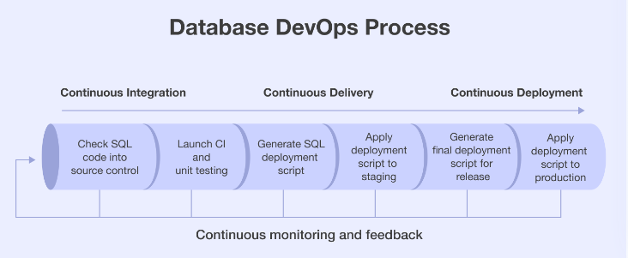
The Database Bottleneck

Slide 8
Database DevOps Challenges
Statistics: According to Liquibase Survey
92% report it’s difficult to accelerate the database deployment process
91% have to rework database changes multiple times before they are ready for production deployment
80% agree it takes longer to deploy database code changes than other changes
Provisioning data for application testing
Data persistence
So Many Tools
People Challenges

Slide 9
How to Overcome Database DevOps Challenges
Source Controlling Code
Synchronize with CI/CD
Smart, self-serve data provisioning : Delphix
Shifting testing left : test on production-like non-production environment

Slide 10
Problems Database DevOps Helps Solve
Unplanned Infrastructure Requests
Testing Database Changes
Protect your production environment
Managing Database and application code (Centralizing Source Control)
Automate Database operations (Synchronizing with CI/CD Pipelines)

Slide 11
Best Practices for Database DevOps
Use the same process for all code delivery
Make small, incremental database changes
Make it easy to merge database changes from multiple sources
Use database change versioning so you have granular control of features
Test early and often
Most Software Processes Practice | Database DevOps Best Practice
Check app code into source control (like Git/GitHub) | Check app code and database code into source control (like Git/Github)
Build artifact with a CI tool (like Github Actions) | Perform database change and Upgrade with validation(automated with SSDT, Flyway etc.)
Store in a repository (like Artifactory) | Build artifact with a CI tool (like Github Actions)
Deploy with a CD tool (like Github Actions) | Store in a repository (like Artifactory)
 | Simulate changes to ensure an ideal state database (automated with SSDT, Flyway etc.)
 | Deploy with a CD tool (like Github Actions)

Slide 12
Tools to implement Database DevOps
Liquibase, a framework to manage database migrations
Flyway, a framework to manage database migrations
DBDeploy, a framework to manage database migrations
DBmaestro, a commercial tool to enable evolutionary database development
RedGate, a commercial tool to enable evolutionary database development
SQl Server Data Tool(SSDT), a database development tool fully integrated into Microsoft Visual Studio
Datical, a commercial tool to enable application release process by automating database release management
Jailer, a tool to extract subsets of data from a database
DiffKit, a framework to compare two sets of data and report any differences
DbUnit, a JUnit extension, used in testing databases
DbFit, a tool to write readable, easy-to-maintain unit and integration tests for your database code.
SQL Server Migration Assistant (SSMA), a tool designed to automate database migration to SQL Server and Azure SQL from alternative database
Delphix , a tool which automates data security, while rapidly deploying data to accelerate development

Slide 13
Thank You

